Slide 1
Bayesian Inference and Kalman Filtering
Edward Wang, Ph.D.

Slide 2
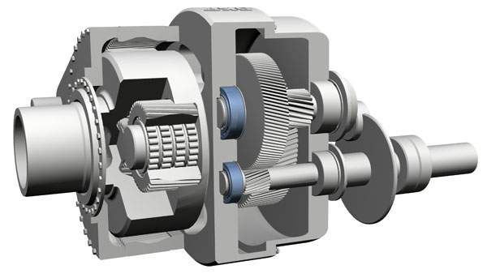
Prognostic Elements
Vibration sensor #2
Investigated part
Vibration sensor #1
Tracking
Inference
Prognosis
Vibration signal #1
z_{k}
Vibration signal #2
Sensor Measurement
(z_{1:k})
Current Part Status
(x_{k})
Part State Propagation
(x_{1:k})
Future Part Status
(x_{k+1, k+2, …} )
Inference: estimate system/part current state, based on current measurement
Tracking: identify propagation of state using historical measurements (recursive inference)
Prognosis: predict state propagation in the future, without available measurement

Slide 3
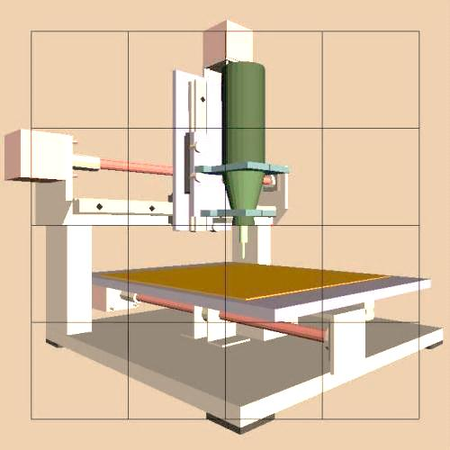
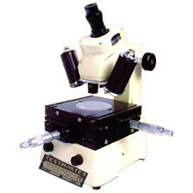
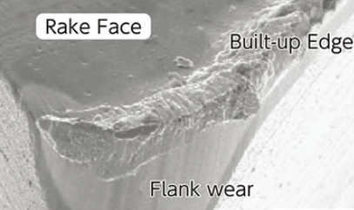
Prognostic Modeling: Pattern Discovery
Online Measurement
Offline Measurement
Machine Structure
Vibration
AE
Spindle Motor
Current/power
Speed
Position
Force/Torque
Microscope
Cutting Process
Cutting force
AE
Vibration
Axis Drive
Current/power
Velocity
Position
Ball Screw
Force
From sensing data to system performance
From sensing data variation pattern to system performance degradation pattern

Slide 4
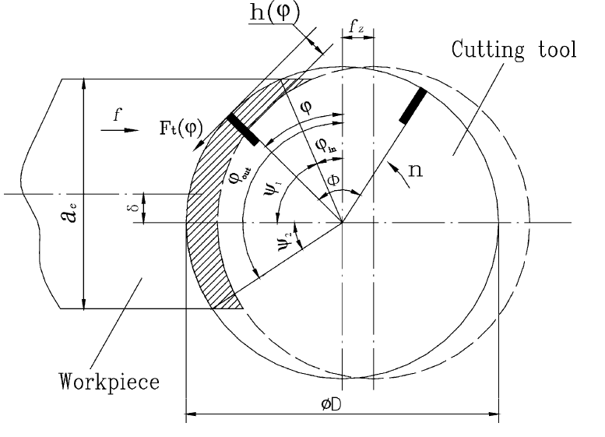

Physical Modeling: Force vs. Wear
Tangential cutting force vs. process parameters ^{[1]}
Proportional to process parameters, i.e. depth of cut and feed rate
Independent of cutting speed, neglecting the effect of strain rate on cutting force
Related to chip thickness
$$F_{t}\left(φ\right)=a_{p}Kh{\left(φ\right)}^{−c}f_{z}sinφ$$
Instantaneous angle of rotation
Force and chip constant
Chip thickness
Axial depth of cut
Feed rate
Tangential cutting force vs. flank wear ^{[2]}
Proportional to sliding friction and width of flank wear VB
Coefficient of sliding friction
Material hardness (e.g. Brinell number)
[1] Altintas and Yellowley, In-process detection of tool failure, J. Engr. Industry, 1989
[2] Shao et al., A cutting power model for tool wear monitoring, J. Machine Tools and Manufacture, 2004

Slide 5
Physical Modeling: Crack Propagation
Paris’ Law ^{[1]}
Describe crack propagation da/dN as a function of stress intensity ∆K and material-dependent parameters, C & m
Modeling of entire crack propagation ^{[2,3]}
Variable | Physical Meaning | Value
R | Stress ratio | 0.7
f | Threshold stress intensity factor | Approximated by crack function ^{[2]}
∆K_{th} | Critical stress intensity factor | A function of f ^{[2]}
K_{max} | Maximum stress intensity factor | ∆K(1-R)
K_{C} | Fracture toughness | 27.7
C; m; p; q | Constant | 6.23e-9; 2.18; 0.5; 2
[1] Paris and Erdogen, Critical analysis of crack propagation laws, J. Basic Engineering, 1963
[2] Mettu et al., NASGRO, Technical Report, 1999
[3] Maierhofer et al., Modified NASGRO equation, Inter. J. Fatigue, 2014

Slide 6
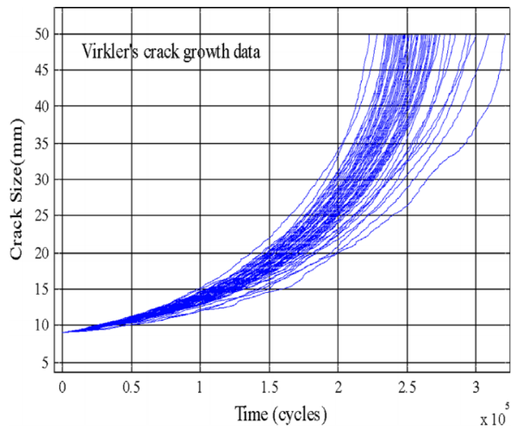
Challenges in Prognostic Modeling
Bearing performance degradation
Machine tool performance degradation
Failure threshold
(FEMTO-ST bearing dataset, 2012)
(Ortiz and Kiremidjian, Engineering Fracture Mechanics, 1988)
Machine performance degradation, subjected to:
Gradual deterioration with time-varying degradation rates or modes
Abrupt fault, leading to transient performance changes
Process-to-process variation, non-Gaussian distributions of machines’ status under same operating condition

Slide 7
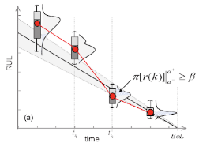
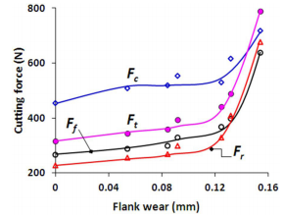

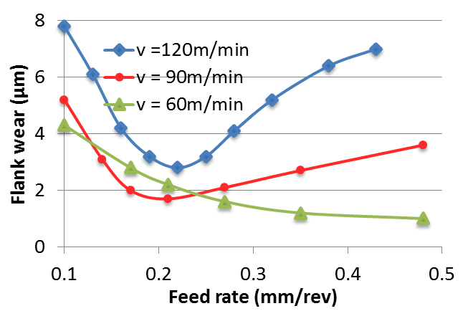
Uncertainties with Prognostic Modeling
Uncertainty
Process
Measurement
Modeling
Varying operating & environmental condition
Measurement noise & sensor failure
Linear vs. nonlinear
Joint nonlinear effect of process parameters
Nonlinear relationship between system state and measurement
Simplification and assumptions
Gaussian vs. non-Gaussian
Process-to-process variation
(Saxena, IJPHM, 2016)
(Chinchanikar, Materials Science, 2014)
(Astakhov, J. Adv. Manuf. Tech., 2007)
(Ortiz, Engr. Fracture Mechanics, 1988)
Notes:
Time-varying degradation: due to varying operational, usage, and load
Measurement error: sensors usually manifest them not as accurate and precise as they are designed, and sensor failure
Nonlinear relationship: tool wear and vibration are not the same physical quantities
Modeling error: due to improper assumption and simplification maded in modeling process

Slide 8
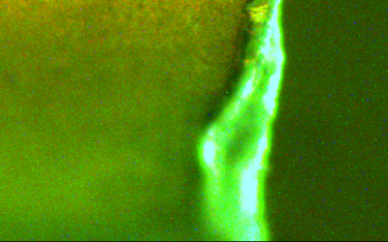
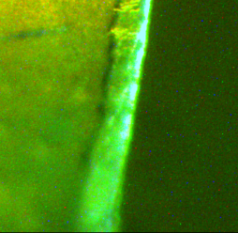
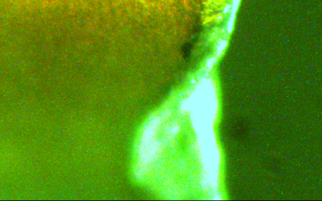
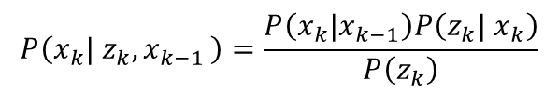


Stochastic and Probabilistic Modeling
Force signal #1
Inference
Estimate the current system state through a posterior PDF ⁽¹⁾, realized via Bayes’ Rule ⁽²⁾
Sensor Measurement
(z_{1:k})
z_{k}
Force signal #2
$$P\left(x_{k}| z_{k}{,x}_{k−1}\right)=\frac{P\left(x_{k}|x_{k−1}\right)P\left(z_{k}| x_{k}\right)}{P\left(z_{k}\right)}$$
Current Part Status
(x_{k})
Posterior PDF
Prior PDF
Constant
Likelihood
Tracking
Identify the state propagation model (or recursively update the prior PDF) through a series of posterior PDF, following a Markov process ⁽³⁾
Part State Propagation
(x_{1:k})
$$\begin{matrix}P\left(x_{1},x_{2},…,x_{k}|z_{1},z_{2},…,z_{k}\right) \\ =P\left(x_{1}|z_{1}\right)P\left(x_{2}|x_{1},z_{2}\right)⋯P\left(x_{k}|x_{k−1},z_{k}\right)\end{matrix}$$
Prognosis
Predict the future state using the identified state propagation model (a series of prior PDF)
Future Part Status
(x_{k+1, k+2, …} )
$$P\left(x_{k+1}|x_{k}\right)P\left(x_{k+2}|x_{k+1}\right)⋯$$
(1) PDF: Probability Density Function
(2) Bayes’ Rule: posterior PDF can be estimated through prior pdf and likelihood
(3) Markov process: current state x_{k} only dependent on preceding state x_{k-1}

Slide 9





Realization: Bayesian Inference
1. Assuming starting with state x_{k-1} at time k-1
probability
$$P\left(x_{k−1}\right)$$
2. Subsequent state x_{k} at time k can be initially predicted using prior PDF, with variance ↑
state
$$P\left(x_{k}\right)=P\left(x_{k−1}\right)P\left(x_{k}|x_{k−1}\right)$$
probability
Following a Markov process
Variance increases as prediction is directly based on assumed prior PDF, without guidance from updated observation
$$P\left(x_{k}\right)$$
state
probability
3. With updated measurement (observation) z_{k}
$$P\left(x_{k}\right)$$
z_{k}
Predicted state $P\left(x_{k}\right)$ will be corrected
state

Slide 10
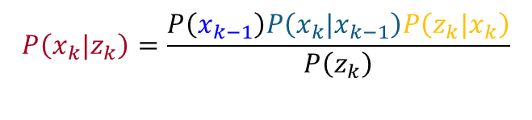




Realization: Bayesian Inference
1. Assuming starting with state x_{k-1} at time k-1
probability
$$P\left(x_{k−1}\right)$$
2. Subsequent state x_{k} at time k can be initially predicted using prior PDF, with variance ↑
state
3. With updated measurement (observation) z_{k}
probability
4. Predicted state x_{k} can then be corrected using Bayes’ rule, leading to a decreased variance ↓
$$P\left(x_{k}\right)$$
state
$$P\left(x_{k}|z_{k}\right)=\frac{P\left(x_{k−1}\right)P\left(x_{k}|x_{k−1}\right)P\left(z_{k}|x_{k}\right)}{P\left(z_{k}\right)}$$
probability
Posterior PDF is calculated by the product of likelihood function P(z_{k} | x_{k}) and prior PDF
Extent of correction is determined by the confidence (or uncertainty level) of prior PDF and measurement
Correction is implemented by Kalman filtering (KF) or particle filtering (PF)
$$P\left(x_{k}\right)$$
z_{k}
state
probability
$$P\left(x_{k}|z_{k}\right)$$
state

Slide 11
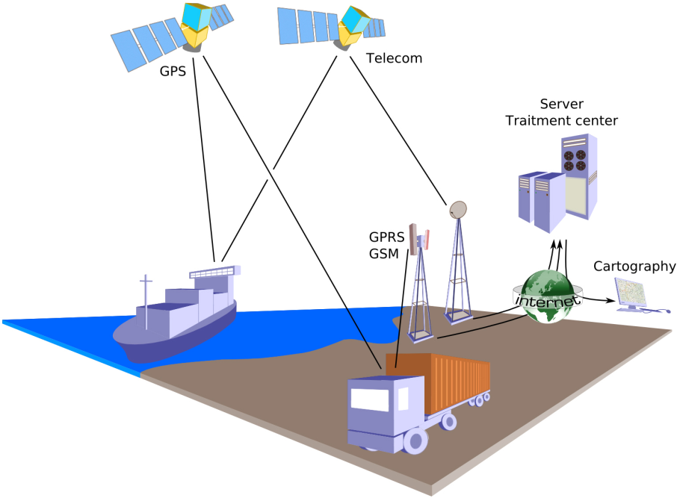
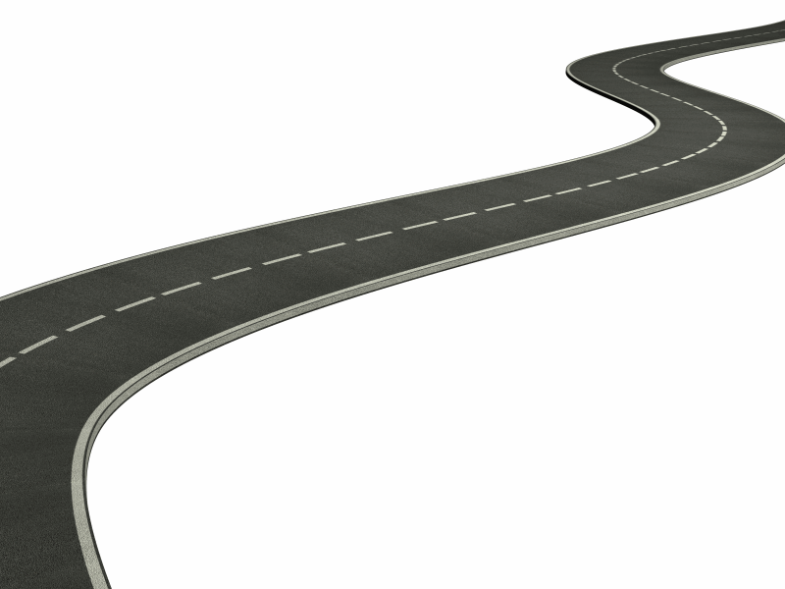

Bayesian for State and Parameter Estimation
State estimation P(x|z)
State evolution model is known
e.g. object tracking (car running on a linear road with constant speed)
Joint state and parameter estimation P(x,θ|z)
State evolution is dominated by unknown parameters
e.g. car running with unknown speed
y
(x_{k}, y_{k})
Speed , (parameters) need to be estimated first, then position (state)
(x_{k-1}, y_{k-1})
x

Slide 12
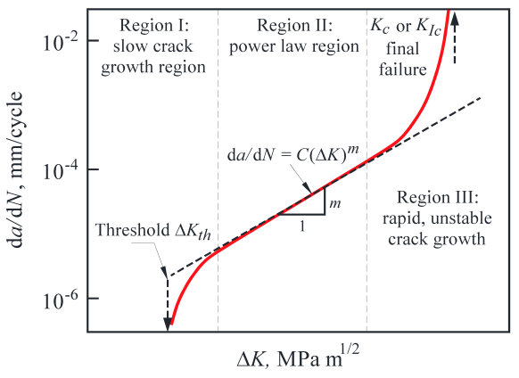
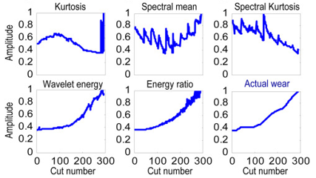

Determine Prior PDF and Likelihood Function
Prior PDF $P\left(x_{k}|x_{k−1}\right)$
a: crack length
N: cut number
ΔK: range of stress intensity
Paris law, describing crack propagation over time (i.e. from x_{k-1} to x_{k})
System state at time k
Parameters to be estimated
Process-to-process variation
Also called State Evolution model
Usually obtained from physical or empirical knowledge
Sometimes conditional on parameters, {A_{k}, B_{k}}, related to system operating conditions
Likelihood Function P(z_{k} | x_{k})
Sensor data or extracted features
System state at time k
Measurement noise
Also called Measurement model

Slide 13
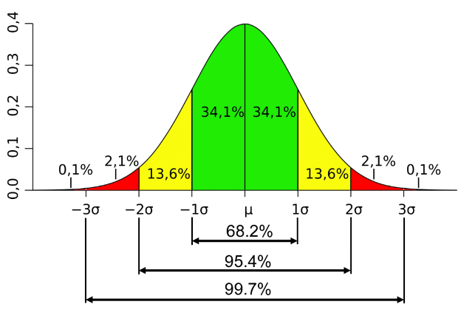
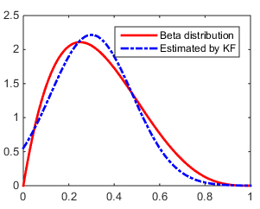
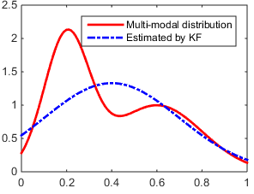
Gaussian vs. Non-Gaussian Inference
State evolution model:
Exponential
Not exact Gaussian
Measurement model:
Variation or Noise (w_{k}, v_{k}) can be Gaussian or Non-Gaussian
Gaussian distribution
Can be fully characterized by first two moments (i.e. mean and variance)
Straightforward to find optimal estimation of unimodal distribution
Non-Gaussian distribution
Conditional PDF of state on time-varying parameters may follow an exponential or multimodal distribution
Can be approximated by random sampling methods, e.g. particle filter
exponential distribution
Multimodal distribution

Slide 14
Linear vs. Non-Linear Inference
State evolution model:
Measurement model:
Case 1: f or g is non-linear but continuous
Extended Kalman Filter (EKF) through linearization
Unscented KF through nonlinear transformation
Particle Filter (PF) through random sampling
g₁
g₂
Case 2: f or g is non-linear but piecewise
Switching or interacting KF/PF (multiple mode KF/PF)

Slide 15
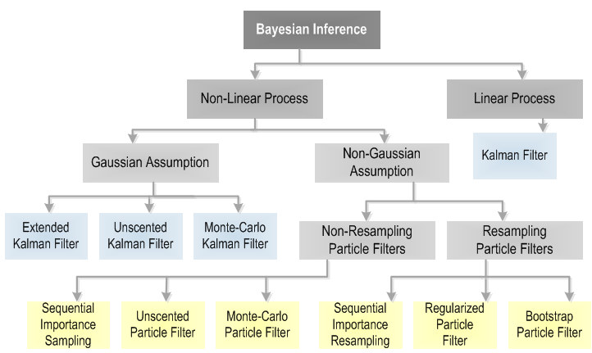
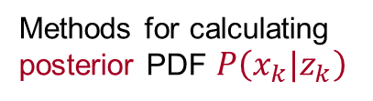
Bayesian Probabilistic Modeling Methods
Methods for calculating posterior PDF $P\left(x_{k}|z_{k}\right)$
Sikorska et al., Prognostic Modelling Options for Remaining Useful Life Estimation. Mechanical Systems and Signal Processing (2013)

Slide 16




Kalman Filter (KF)
Describe a PDF with mean and covariance, thus has the Gaussian assumption
Obtain the optimal estimation by minimizing mean squared error of the estimation
Assume
probability
State model
$$P\left(x_{k−1}\right)$$
Meas. model
state
Covariance of process and meas. noise
probability
Prediction
$$P\left(x_{k|k−1}\right)$$
Equal mean, larger covariance
State
state
Covariance
probability
$$P\left(x_{k|k−1}\right)$$
z_{k}
Update
state
State
probability
Covariance
$$P\left(x_{k}|z_{k}\right)$$
Covariance ↓
Recursively decreasing
Kalman gain
state

Slide 17
Extended Kalman Filter (EKF)
If the state and measurement models are non-linear, standard KF does not work
EKF: use Taylor Series to linearize the models
State model
Meas. model
Prediction
Update
State
State
Covariance
Covariance
KF and EKF can only be applied to Gaussian System that states, parameters and measurements are assumed to follow Gaussian distributions, which may or may not be valid in practice

Slide 18
Simulation

